Slide 1
Using Variables
How do write programs using variables?

Slide 2
Review of How to Submit a Program

Slide 3
what is the difference between a type and a value?

Slide 4
enter the following code and be prepared to discuss
(define width 100)
(define radius
(* width 1/2))
(define rc
(circle radius "solid" "red"))
1
1
3
4
6
7

Slide 5
composition of functions: putting one function inside of another
Interpret the following line of code.
(* 5 (+ 3 2))
...and this one?
(rotate 45
(triangle 50 "solid" "green"))
How many parameters does rotate have? How do we answer this question?

Slide 6
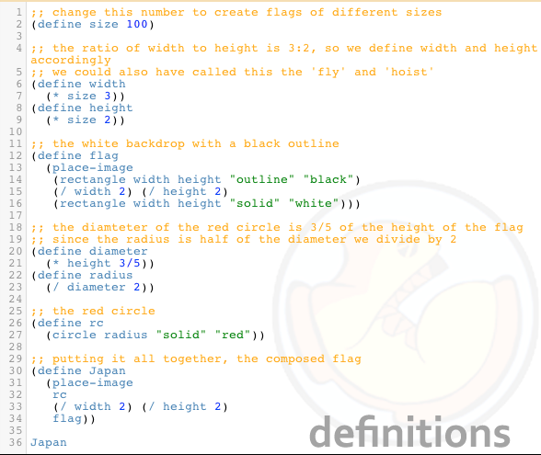
Flag of Japan Program

